Slide 1
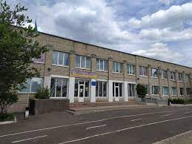
International Contact Webinar: Supporting Ukraine in VET
23 November 2023
State educational institution "Izyum Regional Center of Vocational Education"

Slide 2
International Contact Webinar: Supporting Ukraine in VET
23 November 2023
Izyum regional center of professional education today:
329 students studying professions:
Electrician fitter repairing electrical equipment
Electric gas boiler
Locksmith repairing wheeled vehicles
Electric welder for manual welding
Cook
Confectioner
Mason
Plasterer
Machine tool of a wide profile
Cook
Waiter
Bartender
Computer operator,
Delivery Agent, Office Clerk (Accounting)
Locksmith repairing agricultural machines and equipment,
Agricultural tractor driver,
Motor vehicle driver

Slide 3
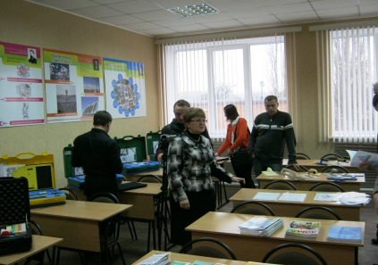
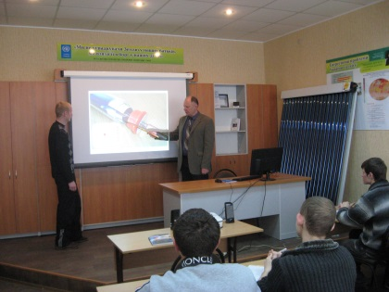
International Contact Webinar: Supporting Ukraine in VET
23 November 2023
The main directions of the center's work
An educational and information center on energy efficiency has been created
The subject "Fundamentals of energy efficiency" is included in all curricula, according to which students from all professions are trained.
The training manuals "Fundamentals of energy efficiency" and "Energy conservation in the construction industry of Ukraine" have been developed and are undergoing approval

Slide 4
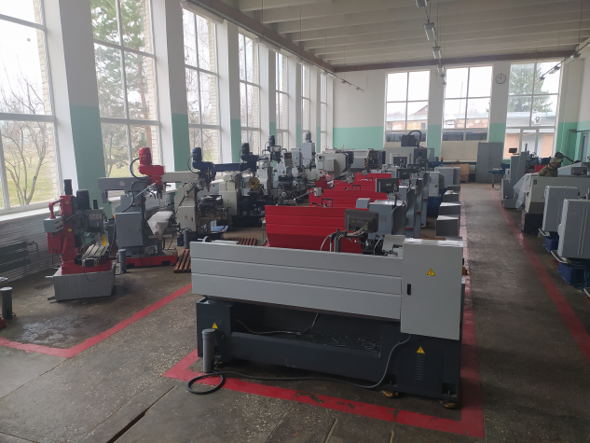
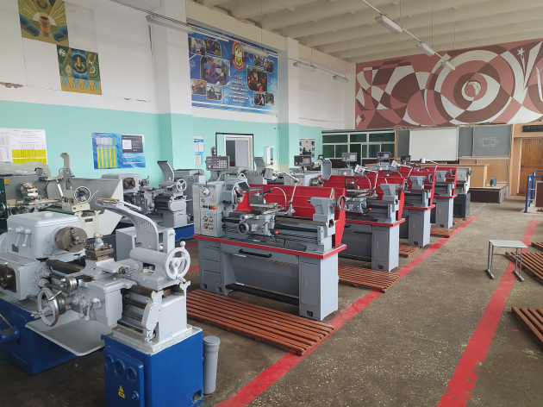
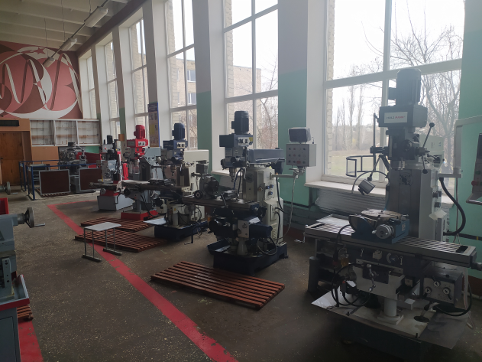
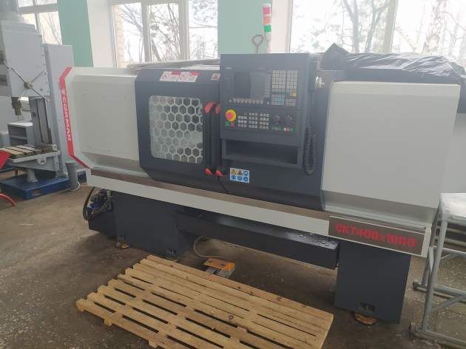
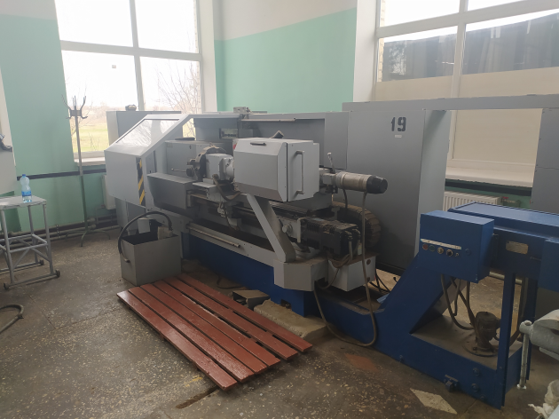
International Contact Webinar: Supporting Ukraine in VET
23 November 2023
An educational and practical center for modern metalworking technologies has been created
Pupils are trained in the professions of turner, machine tool of a wide profile, and training of teaching staff is carried out.

Slide 5
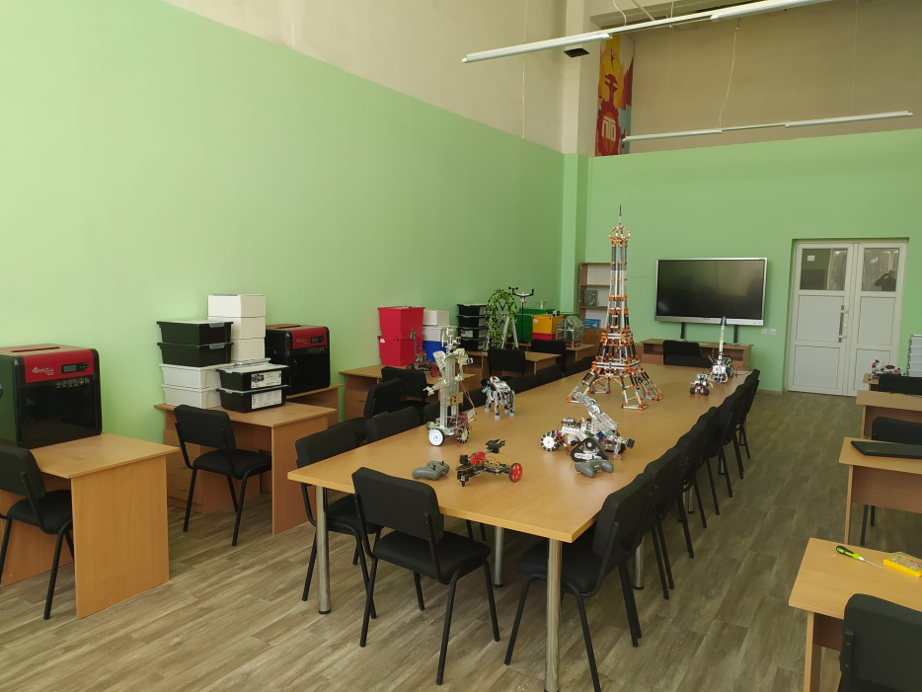
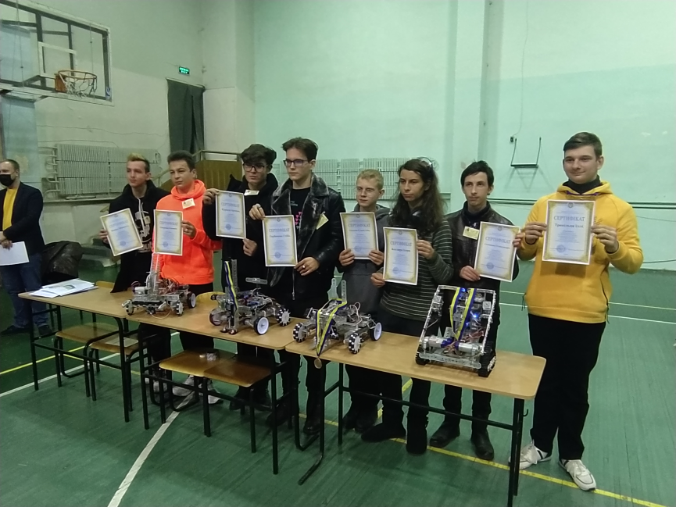
International Contact Webinar: Supporting Ukraine in VET
23 November 2023
A STEM laboratory was created
Part-time employees have the opportunity to conduct lessons using the capabilities of the laboratory
Pupils of the center are participants in the regional robotics competition

